Slide 1

Receipt and Invoice Digitizer
Project Team
1
Venkata Sai Pranavi -Frontend and AI Integration
Infosys Springboard
Mentor: Shakthi Gopala Krishnan
Snehitha Savula- UI/Frontend developer
2
3
Booma Manjunath-Backend Developer
Gnana Pravallika-OCR Developer
4
5
Kummari Nikhil-Documentation Developer

Slide 2

Problem Statement
Tackles the challenge of managing large volumes of receipts and invoices that are often disorganized.
Minimizes errors inherent in manual receipt and invoice processing.
Overcomes inefficiencies of traditional, paper-based methods.
Introduces a digital platform that automates receipt and invoice handling.
Provides a structured system for organized storage and easy retrieval.
Reduces manual workload and streamlines financial tracking.
Enhances accuracy and reliability in financial recordkeeping.

Slide 3
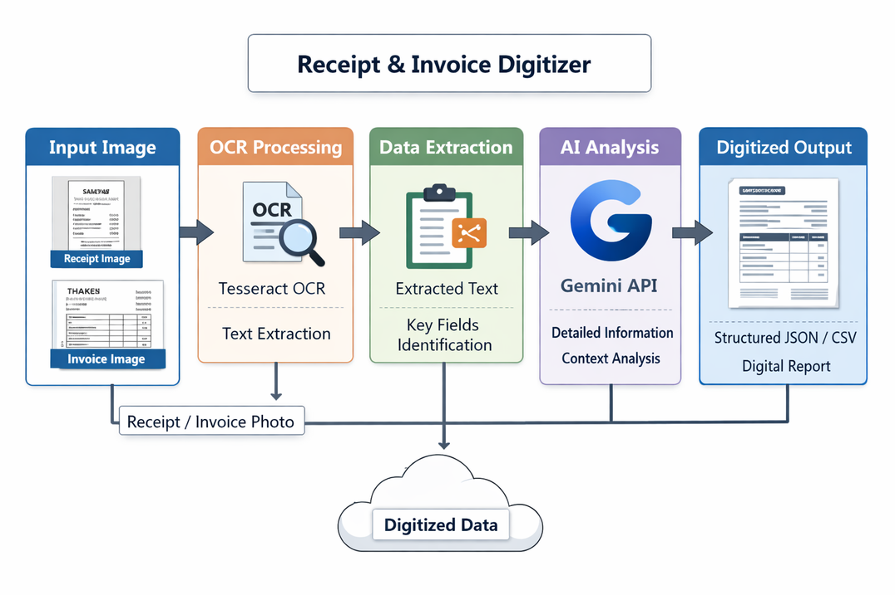
Architecture and workflow

Slide 4
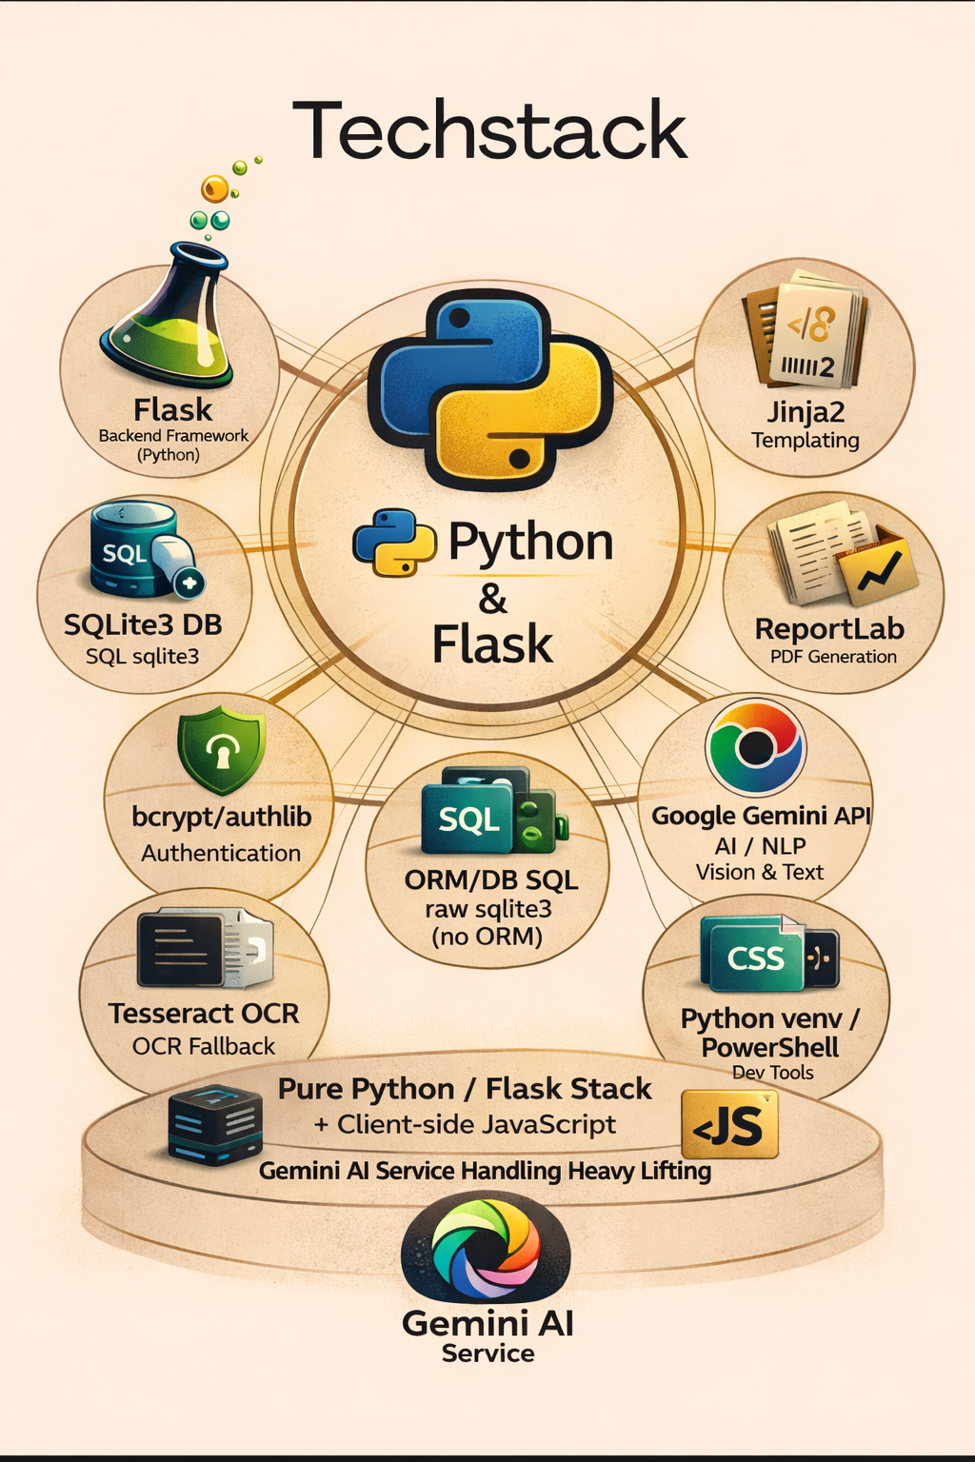
Techstack

Slide 5
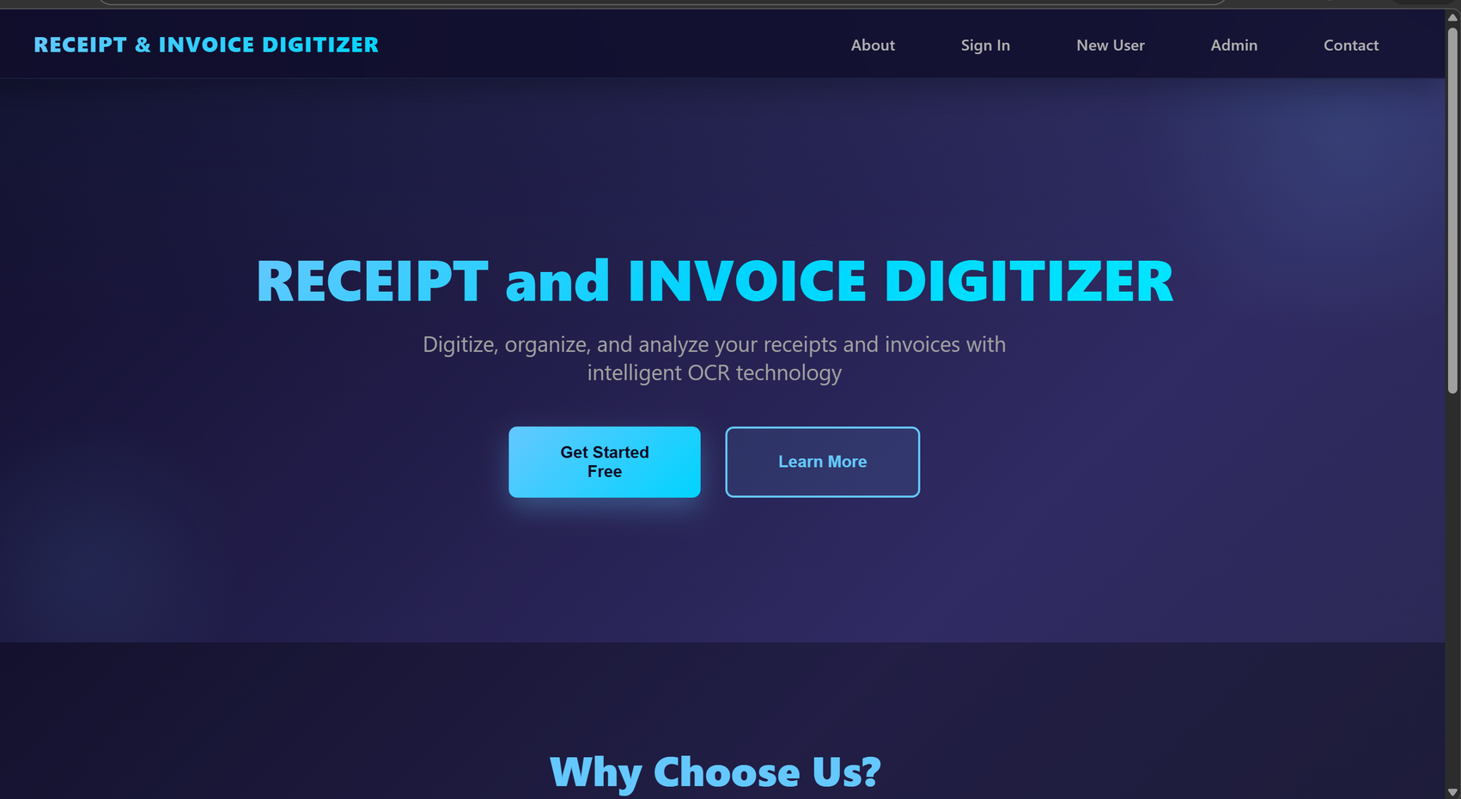
Landing Page
Serves as the welcoming gateway, setting a clear tone for user interaction.
Streamlines access to key areas like About, Sign In, New User registration, Admin, and Contact with intuitive navigation.
Empowers users to find and engage with core features effortlessly from a sleek top menu.
Balances professionalism with simplicity to create an inviting first impression.
Designed to reduce user hesitation and accelerate onboarding to the Receipt & Invoice Digitizer system.

Slide 6
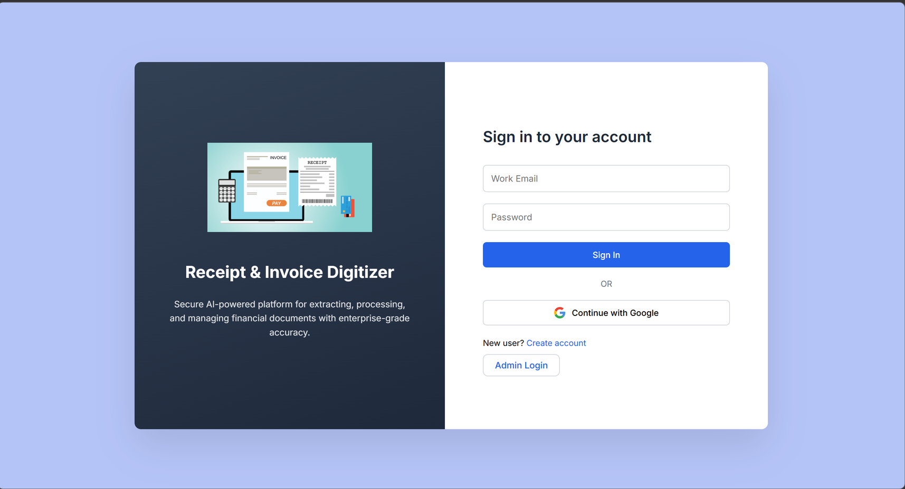
User and Admin Login Pages
Secure user authentication system that allows registered users to log in using their email and password.
Provides access to the receipt digitization dashboard after successful login.
Supports Google OAuth login for faster and convenient authentication.
Ensures data security and session management to protect user accounts and stored receipts.
Includes a separate Admin Login that requires a secret admin code to access administrative controls and user management features.

Slide 7
User Dashboard
User Dashboard Displays uploaded receipts and extracted details such as merchant, date, total amount, and items.
Shows analytics and visual charts for spending patterns and top merchants.
Allows users to upload new receipt or invoice images for digitization.
Provides a detailed view of each receipt including tax, discounts, and payment method.
Enables users to manage and review their digitized receipts in an organized format.

Slide 8
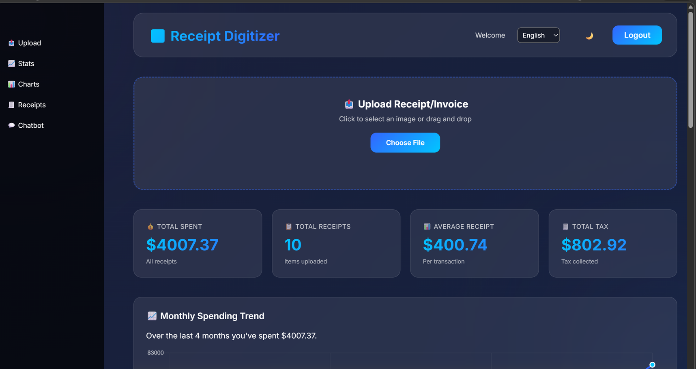
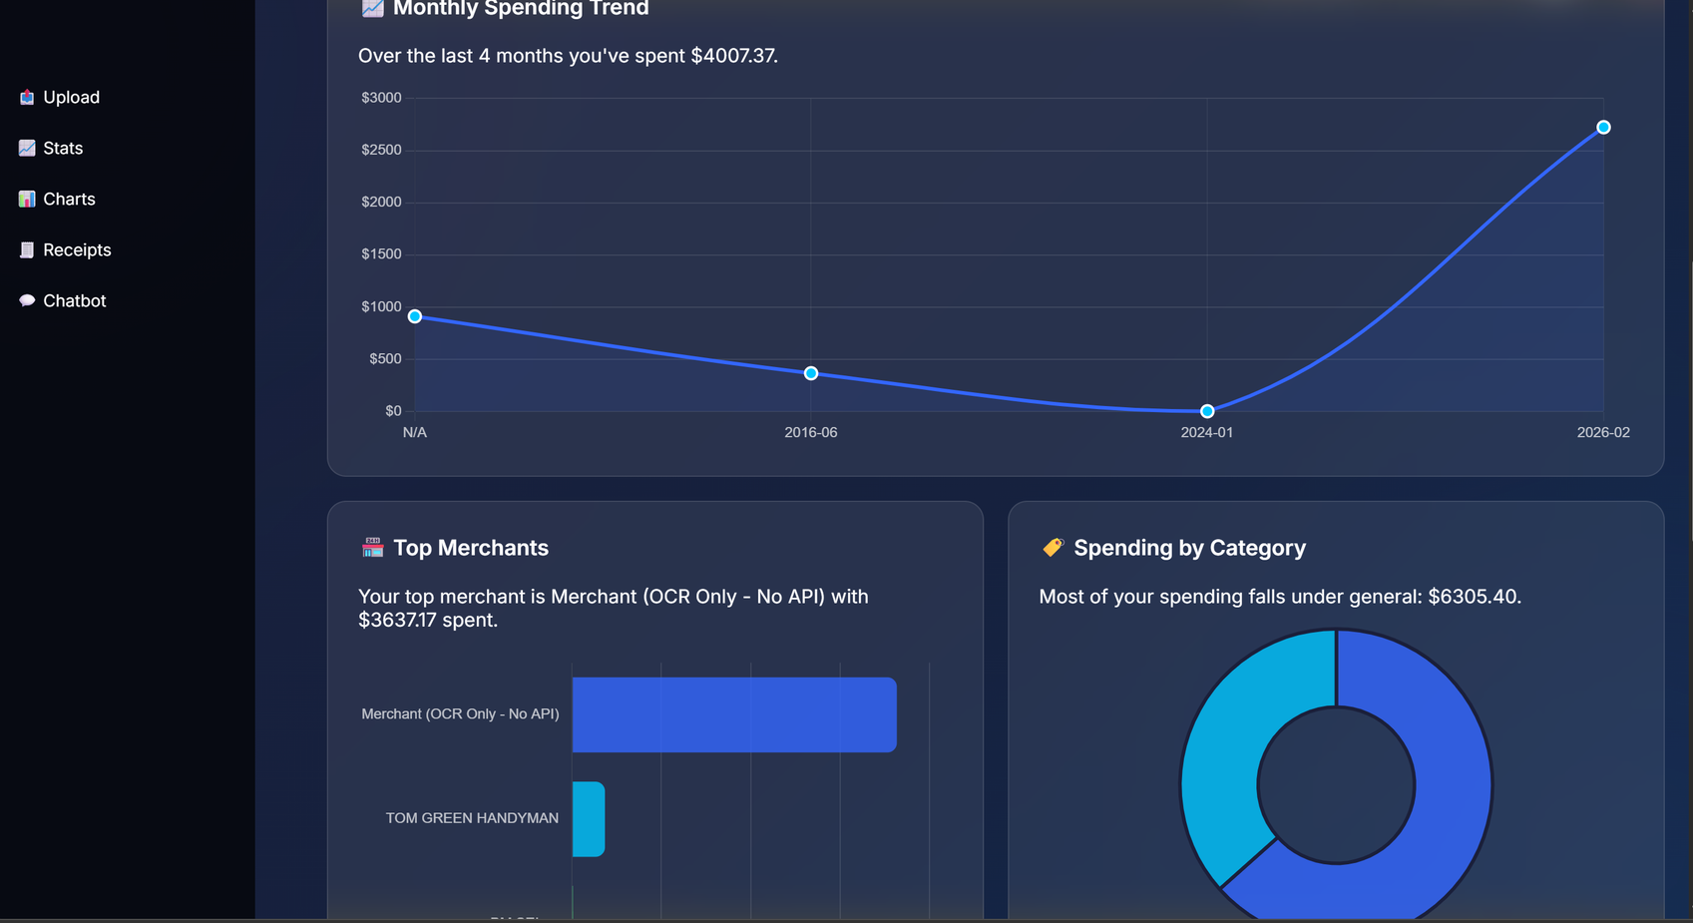
User Dashboard

Slide 9
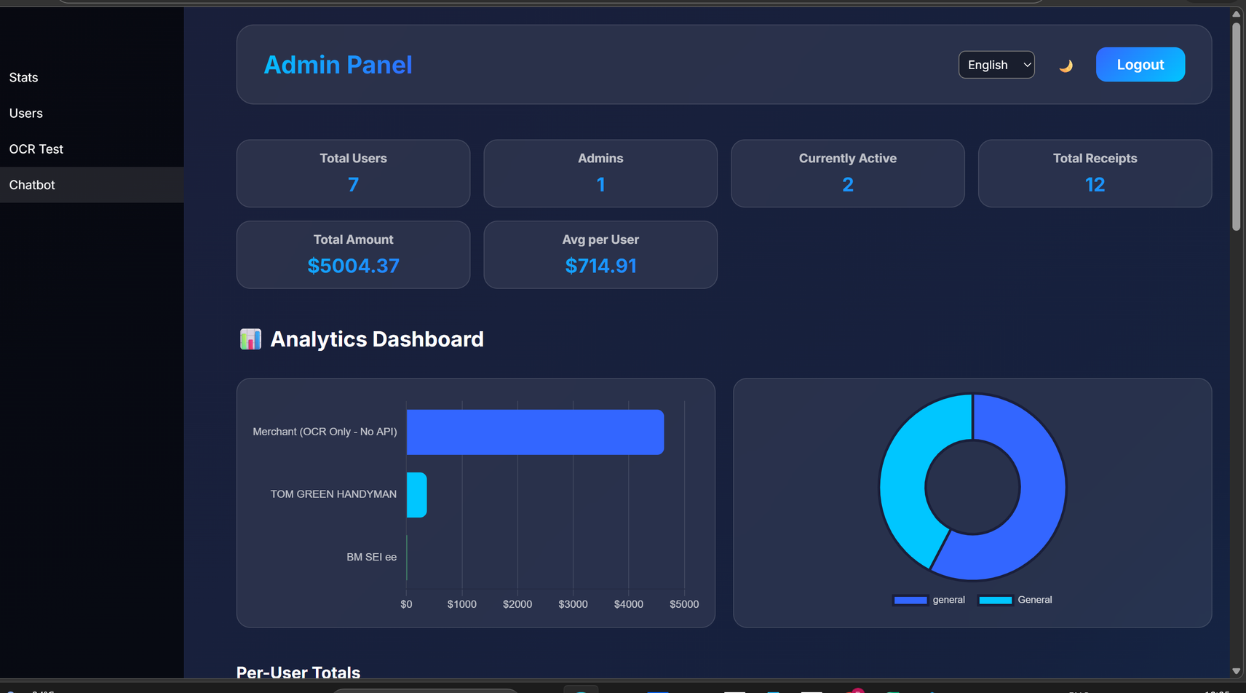
Admin Dashboard
Displays overall system statistics such as total users and active users.
Provides a complete list of registered users with account details.
Allows admins to monitor user activity and receipt uploads.
Highlights currently active users in the system.
Enables administrative control and system monitoring through a centralized panel

Slide 10
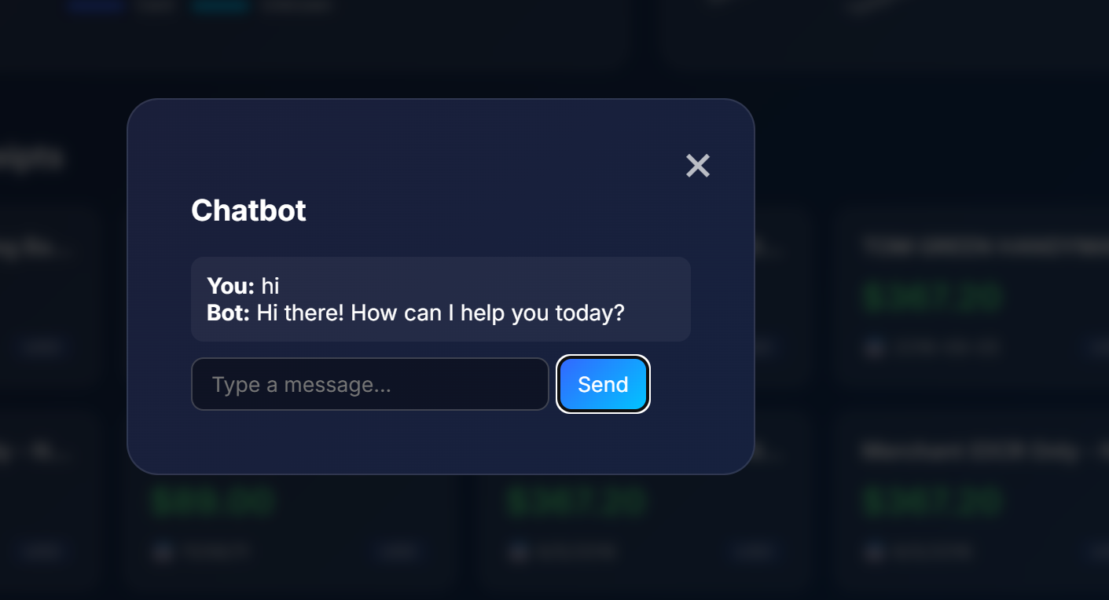
Chatbot
Functionalities:
AI chatbot allows users to interact with digitized receipt and invoice data.
Users can ask questions like “What does this application do.”
The chatbot processes queries using the Gemini API.
Provides quick, accurate responses to improve user experience.

Slide 11
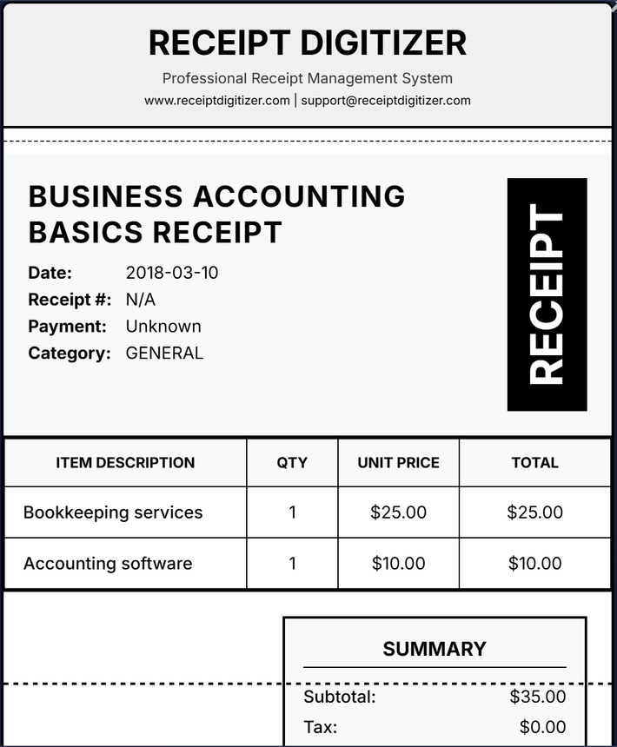
Digitization
The system accepts a receipt image uploaded by the user.
OCR (Optical Character Recognition) extracts text from the receipt automatically.
Important details like date, vendor name, total amount, and items are identified.
The extracted data is converted into a structured digital receipt format.
The digitized receipt can be stored, searched, and used for expense tracking.

Slide 12
Future Enhancements
Database Access for Chatbot – Enable the chatbot to securely query the database to answer user questions about stored receipts, expenses, and transaction history.
Email Verification System – Implement email validation during registration to ensure authentic users and improve account security.
Password Reset via Email – Add a secure password recovery system using email verification links.
Smart Expense Insights – Use AI to provide personalized spending analysis and recommendations based on stored receipt data.
Advanced Anomaly Detection – Detect unusual expenses or duplicate receipts using machine learning techniques.

Slide 13
Conclusion
The Receipt & Invoice Digitizer successfully automates the process of converting paper receipts into structured digital data using OCR and AI.
Integration of Tesseract OCR and Google Gemini enables accurate text extraction and intelligent data interpretation.
The system provides user and admin dashboards for efficient receipt management, analytics, and system monitoring.
Overall, the solution improves expense tracking, data organization, and accessibility compared to manual record keeping.

Slide 14
Thank you!

